Slide 1
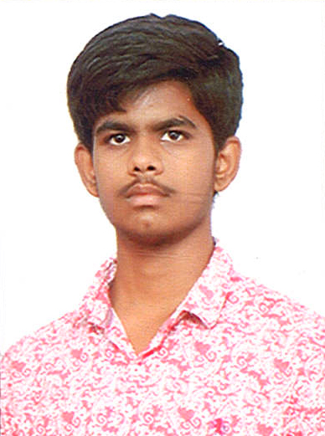
L Dilli prasad
Contact Details
Mobile : 9676462684 Office:
Email : ldilliprasad@sachetassolutions.com
Experience
Total Experience : 5 months
Professional Experience : RPA(5 months)
Technical Skills
RPA Skills
Automation Anywhere (Proficient)
Blue Prism (Beginner)
Ui Path (Beginner)
Other Technical Skills
Java
C#
ASP.NET
Web Development (HTML, CSS)
2019 Learning Curve
Python and Machine Learning
Qualification :
Graduation in Bachelor of computer applications
Hobbies :
Playing outdoor games, browsing internet, solving Rubix cube

